Slide 1
Covid-19 analysis
Phase-2

Slide 2
Introduction
I chose to visualise the COVID-19 vs. Vaccines in India Until the late 2020, India has been quite successful in keeping the new case at almost 0, followed by a rapid and extensive vaccination. However, there was an exponential increase of the daily new cases in the mid-April. As a Washington post article analyses, this surge is explained by the people moving to and from use ,a . Furthermore, while this visualization does not allow to see the geographical dispersion of the covid-19 cases, the same article says the hardest hit area is located near the border. In terms of the relationship between the daily cases and vaccinations, the recent spike has clearly decelerated the process of vaccination in India

Slide 3
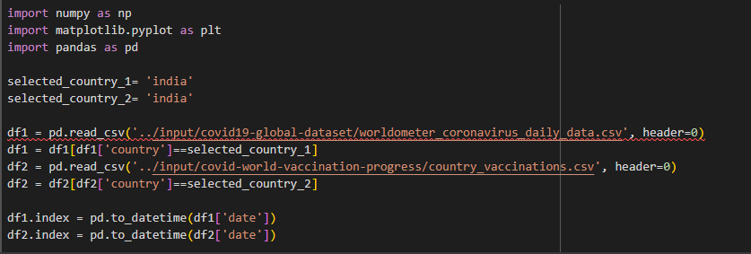

Slide 4
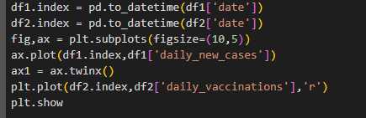

Slide 5
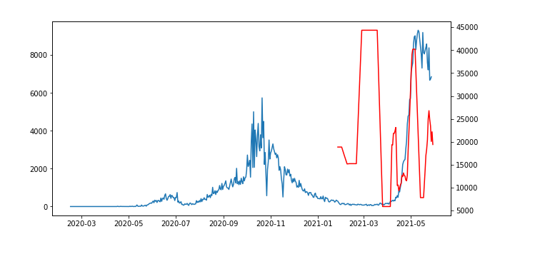

Slide 6
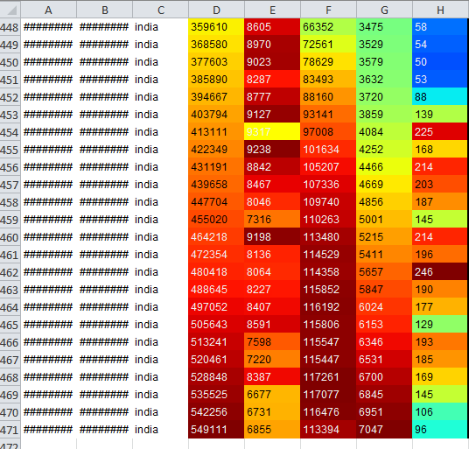

Slide 7
Summary Data Columns Description:
country: designates the Country in which the the row's data was observed.
continent: designates the Continent of the observed country.
total confirmed: designates the total number of confirmed cases in the observed country.
total deaths: designates the total number of confirmed deaths in the observed country.
total recovered: designates the total number of confirmed recoveries in the observed country.
active cases: designates the number of active cases in the observed country.
serious_or_critical: designates the estimated number of cases in serious or critical conditions in the observed country.
total_cases_per_1m_population: designates the number of total cases per 1 million population in the observed country.
total_deaths_per_1m_population: designates the number of total deaths per 1 million population in the observed country.
total_tests: designates the number of total tests done in the observed country.
total_tests_per_1m_population: designates the number of total test done per 1 million population in the observed country.
population: designates the population count in the observed country.

Slide 8
Daily Data Columns Description:
date: designates the date of observation of the row's data in YYYY-MM-DD format.
country: designates the Country in which the the row's data was observed.
cumulative_total_cases: designates the cumulative number of confirmed cases as of the row's date, for the row's country.
daily_new_cases: designates the daily new number of confirmed cases on the row's date, for the row's country.
active cases: designates the number of active cases (i.e., confirmed cases that still didn't recover nor die) on the row's date, for the row's country.
cumulative_total_deaths: designates the cumulative number of confirmed deaths as of the row's date, for the row's country.
daily_new_deaths: designates the daily new number of confirmed deaths on the row's date, for the row's country.

Slide 9
Thank you

